Slide 1

Project Overview
Single Player 2D Platformer
Main Features:
Animated Player
Seven Levels
User Interface(UI)
Enemies/Obstacles
Leaderboard

Slide 2
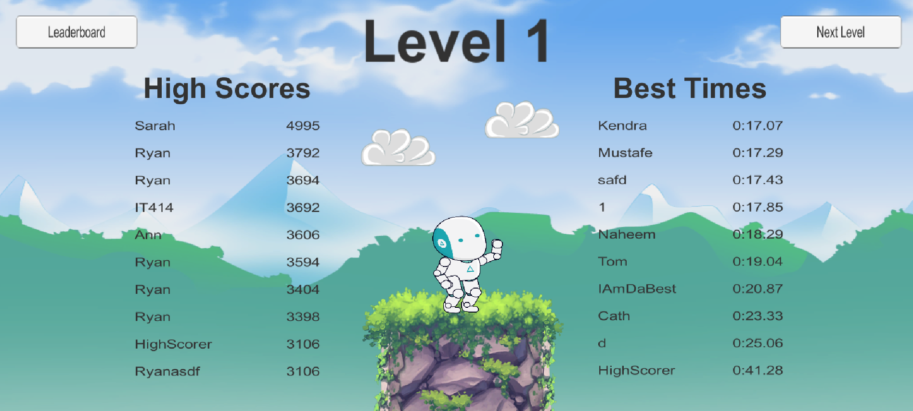
Project Overview : Leaderboard

Slide 3
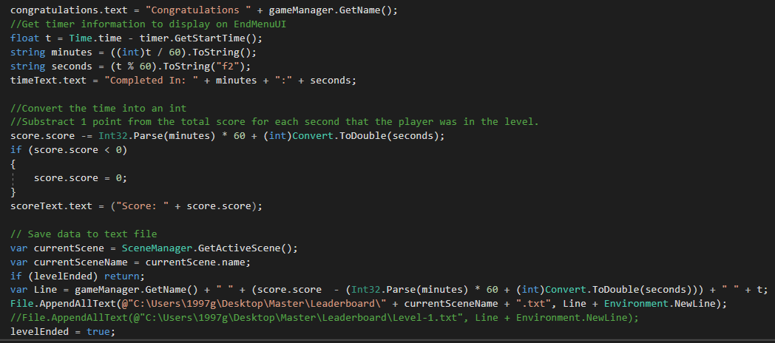
Technology: Leaderboard – Store Data
Notes:
Learning Unity/Finding Assets: Gabe
Communication: Mustafe
User Interface: Ryan
SQL server: Naheem Starts, Ryan Finishes

Slide 4
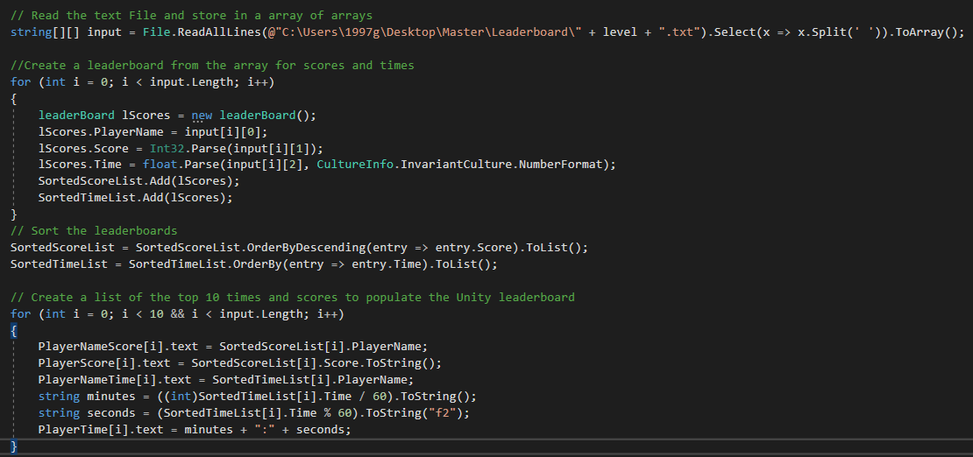
Technology: Leaderboard – Retrieve Data
Notes:
Learning Unity/Finding Assets: Gabe
Communication: Mustafe
User Interface: Ryan
SQL server: Naheem Starts, Ryan Finishes

Slide 5

Technology: Physics2D Engine
Handles physical simulation in Unity
This includes acceleration, proper mass, gravity and other forces
Work similarly is 2D AND 3D development
We use it for falling platform, falling spike, and bullets
Notes:
Learning Unity/Finding Assets: Gabe
Communication: Mustafe
User Interface: Ryan
SQL server: Naheem Starts, Ryan Finishes

Slide 6
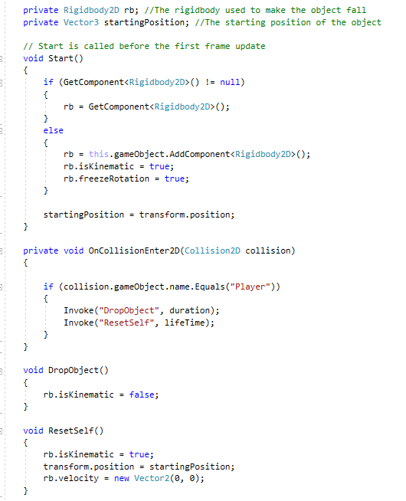
Technology: Physics2D Engine In Code
private Rigidbody2D rb; (object fall)
private void OnCollisionEnter2D(Collision2D collision); (execute on collision)
rb.isKinematic = false; (turnoff forces on collision)

Slide 7
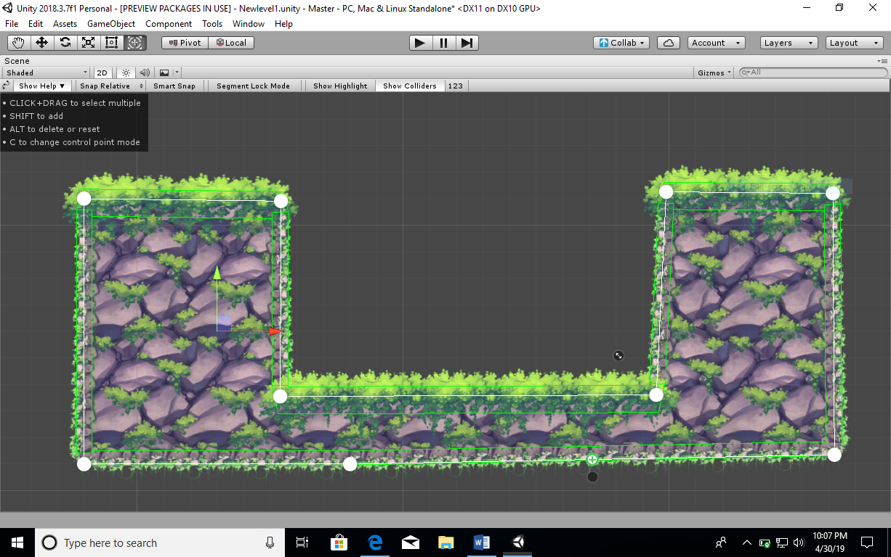
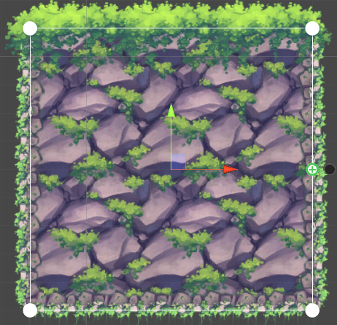
Technology: Ferr2D
Physical 2d Terrain
Decorative 2d Terrain
Ferr2D Terrain Tool allows you quickly create a 2d level.
creating terrain object was easy. All you need to do is just pick or create a terrain material and set up the path interface.
Important things to know
White points
Plus sign buttons
Scale handles
Notes:
Learning Unity/Finding Assets: Gabe
Communication: Mustafe
User Interface: Ryan
SQL server: Naheem Starts, Ryan Finishes

